Slide 1
ALDAR University College
School of Engineering and Technology
I/O Interfacing
Dr. Osama Hosameldeen

Slide 2
Features of the 8255A
The 8255A is a programmable universal I/O interface for digital signals. It has been designed for compatibility with the 8085A microprocessor (and other processors with 8-bit data bus structures)
It features :
  24-bits of digital I/O
    2x 8-bit ports plus 2x 4-bit ports or 3x 8-bit ports
  2x 8-bit Unidirectional Ports with Handshaking
  1x 8-bit Bidirectional Port with Handshaking plus 1x 8-bit port
  Bit set / bit reset on 8-bits ( port C)

Slide 3
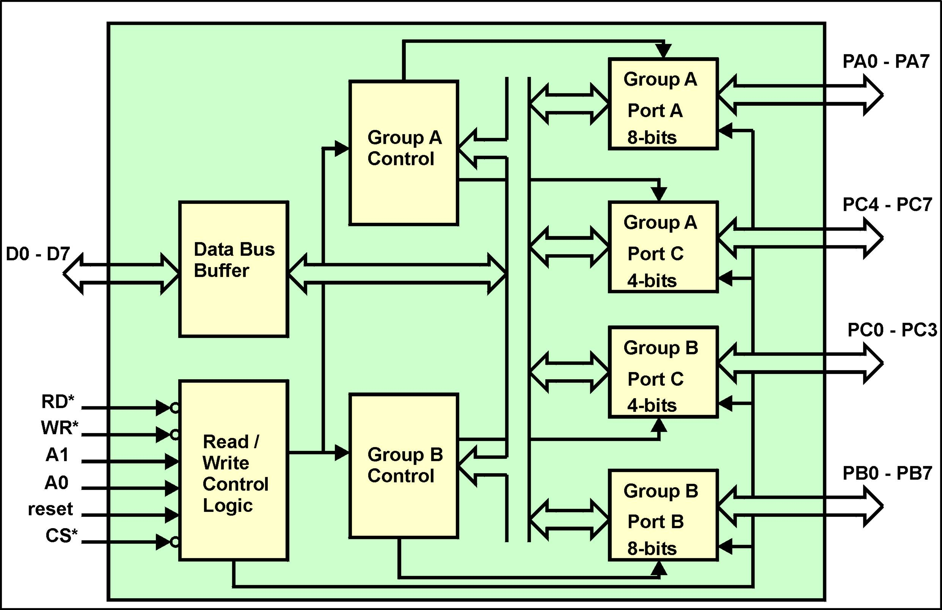
Architecture of the 8255A

Slide 4
8255A Block Functions
Data Bus Buffers
  Are bi-directional tri-state buffers to interface the internal 8-bit bus of the 8255A to the system data bus.
Read/Write Control Logic
  The CS/ input is driven by the decoded address lines A2 - A7. The A1, A0 inputs identify any one of four internal registers. The reset input, when asserted, resets the 8255A to a default configuration (it is usually driven by the processors resetout control line). RD/ and WR/ specify the direction of data flow.
Ports
  There are four ports which can be configured as either input or output. Port A is an indivisible 8-bit port. Port B is an indivisible 8-bit port. Port C (upper) is an indivisible 4-bit port. Port C (lower) is an indivisible 4-bit port.

Slide 5
8255A Block Functions
Group Control Logic
  The group control logic block comprises registers that can be programmed by the processor and combinational circuitry whose configuration is a function of the controlling registers. The combinational circuitry controls the modes in which the ports operate.
  The group control logic is split into two similar subsytems - group A control which configures Port A and the upper 4-bits of Port C. group B control which configures Port B and the lower 4-bits of Port C.

Slide 6
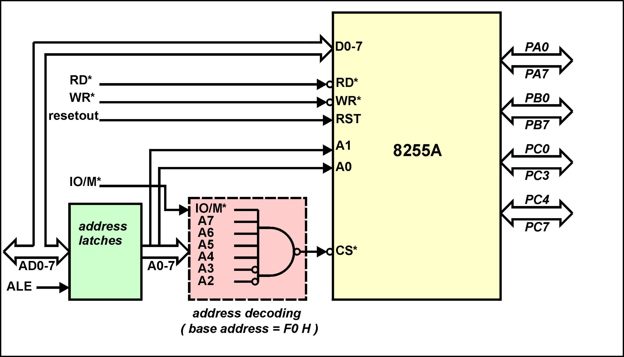
8255A - 8085A Interface

Slide 7
8255A Addresses and Initialisation
The 8255A has four addressable I/O locations
  base address + 0 A1, A0 = 00 Port A
  base address + 1 A1, A0 = 01 Port B
  base address + 2 A1, A0 = 10 Port C
  base address + 3 A1, A0 = 11 Control Register
Before the 8255A can be used it must first be configured. This is accomplished by the processor writing a mode word to the control register.
The mode word specifies whether the ports be input ports, output ports or bi-directional ports and the manner in which the ports are to operate.

Slide 8
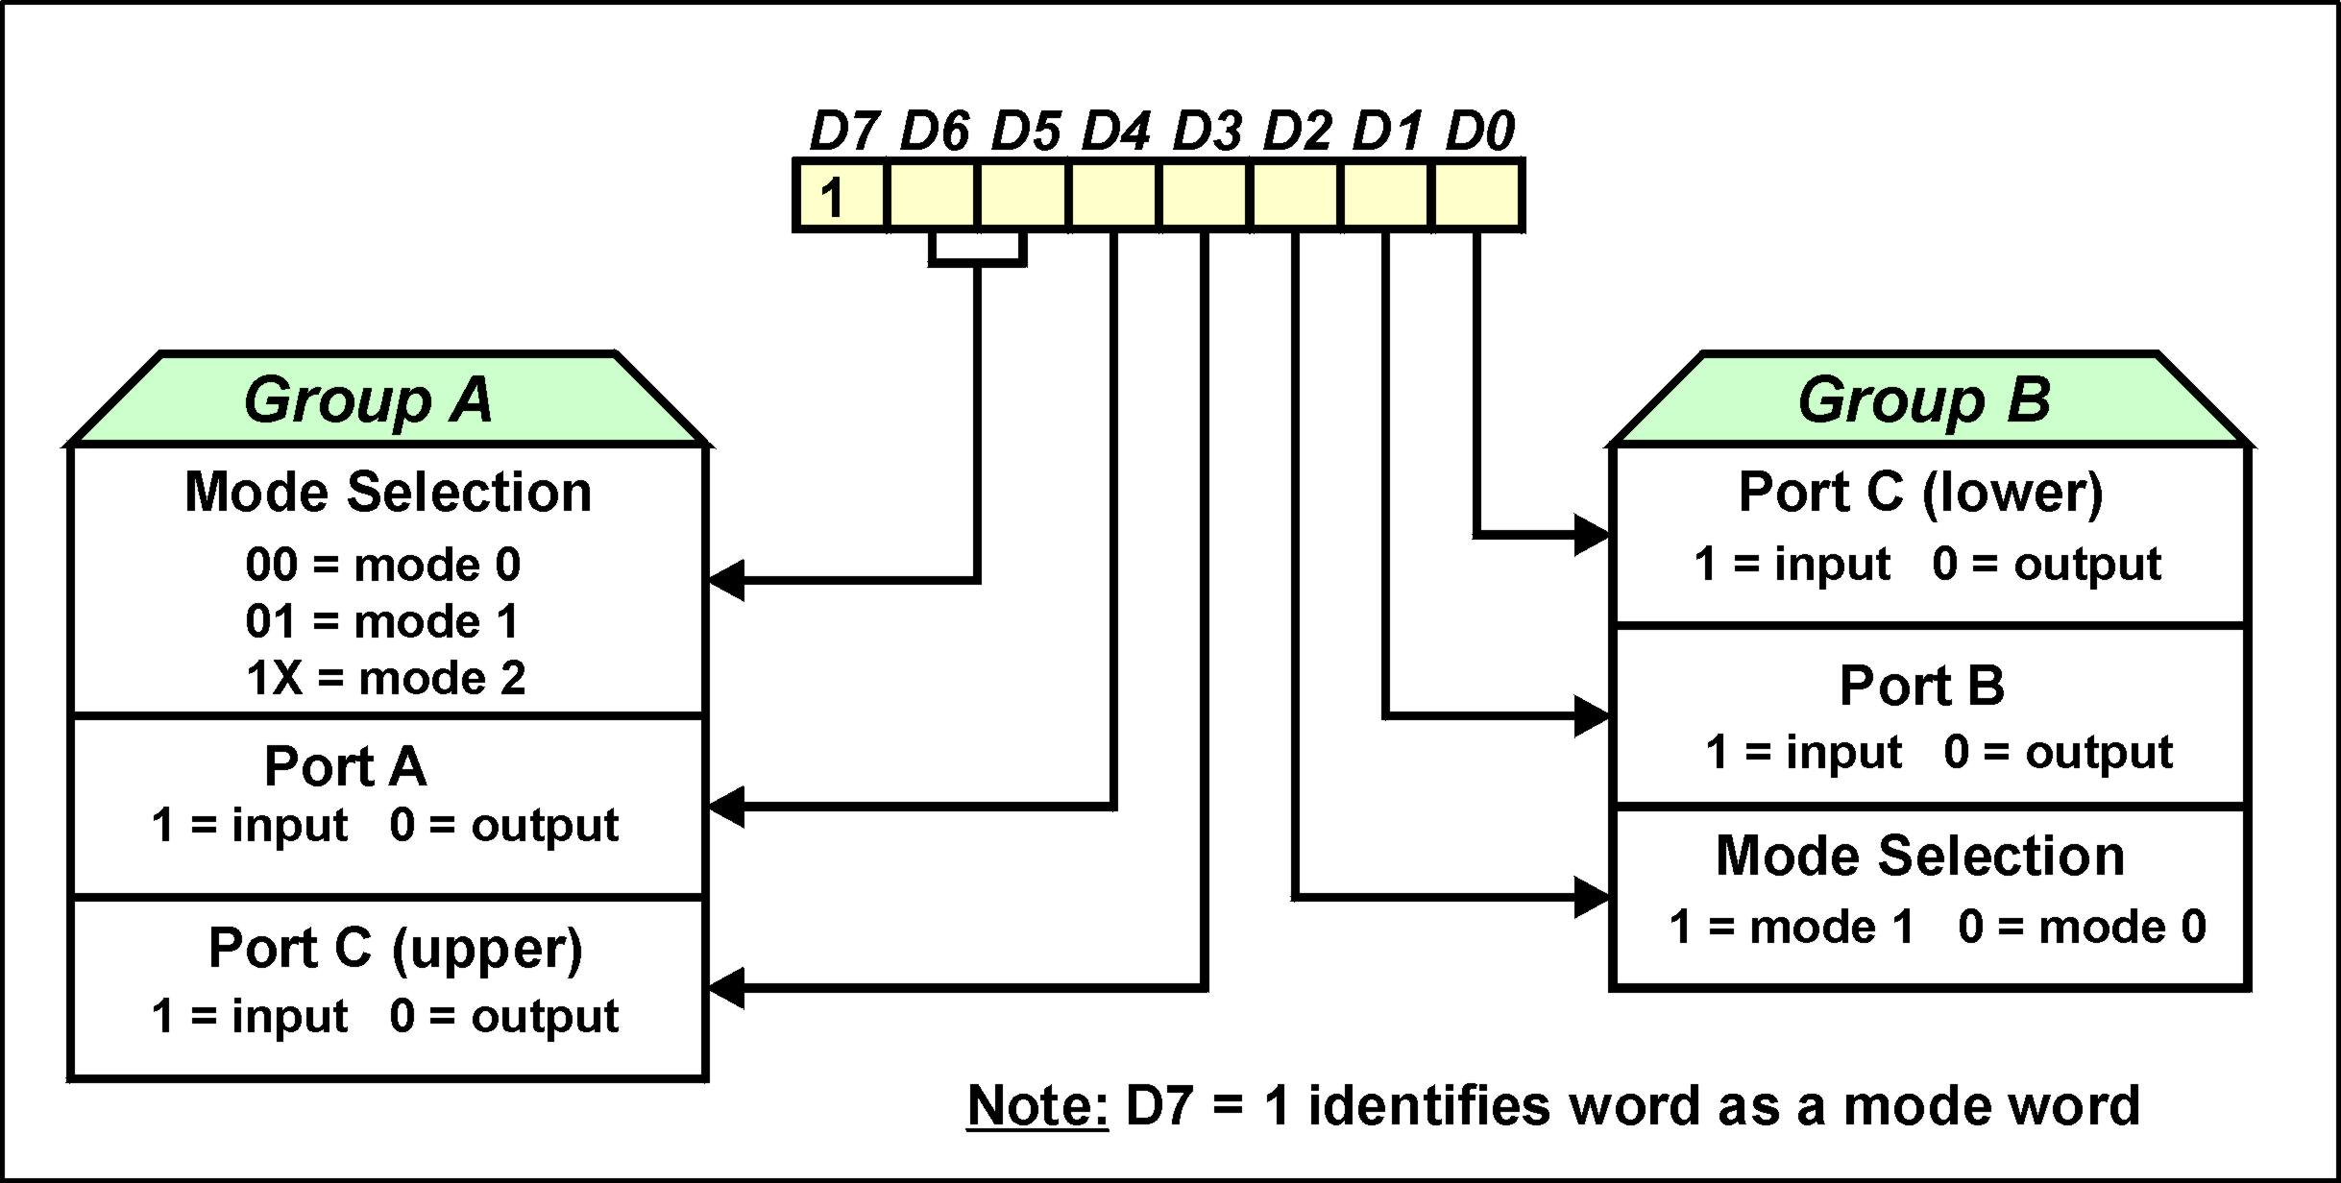
Mode Word Definition for the 8255A

Slide 9
Example of 8255A Initialisation
Example : Write the initialisation code for an 8255A at base address F0 H such that :
  Both groups A & B operate in mode 0
  Port A 8-bit input port
  Port B 8-bit output port
  Port C ( upper) 4-bit output port
  Port C ( lower) 4-bit input port
    MVI A, 91 H ; Control word
    OUT F3 H ; Control port

Slide 10
Operational Modes - Mode 0
Mode 0 for the 8255A is referred to as the simple I/O mode
Ports A & B are used as simple 8-bit input or output ports. Port C (upper) & Port C (lower) are used as simple 4-bit input or output ports.
When used as output ports the data from the processor is latched.
When used as input ports, the data from the peripheral device is not latched. The port appears as simple tri-state buffers.
There are no handshaking signals between the port and the peripheral device.

Slide 11
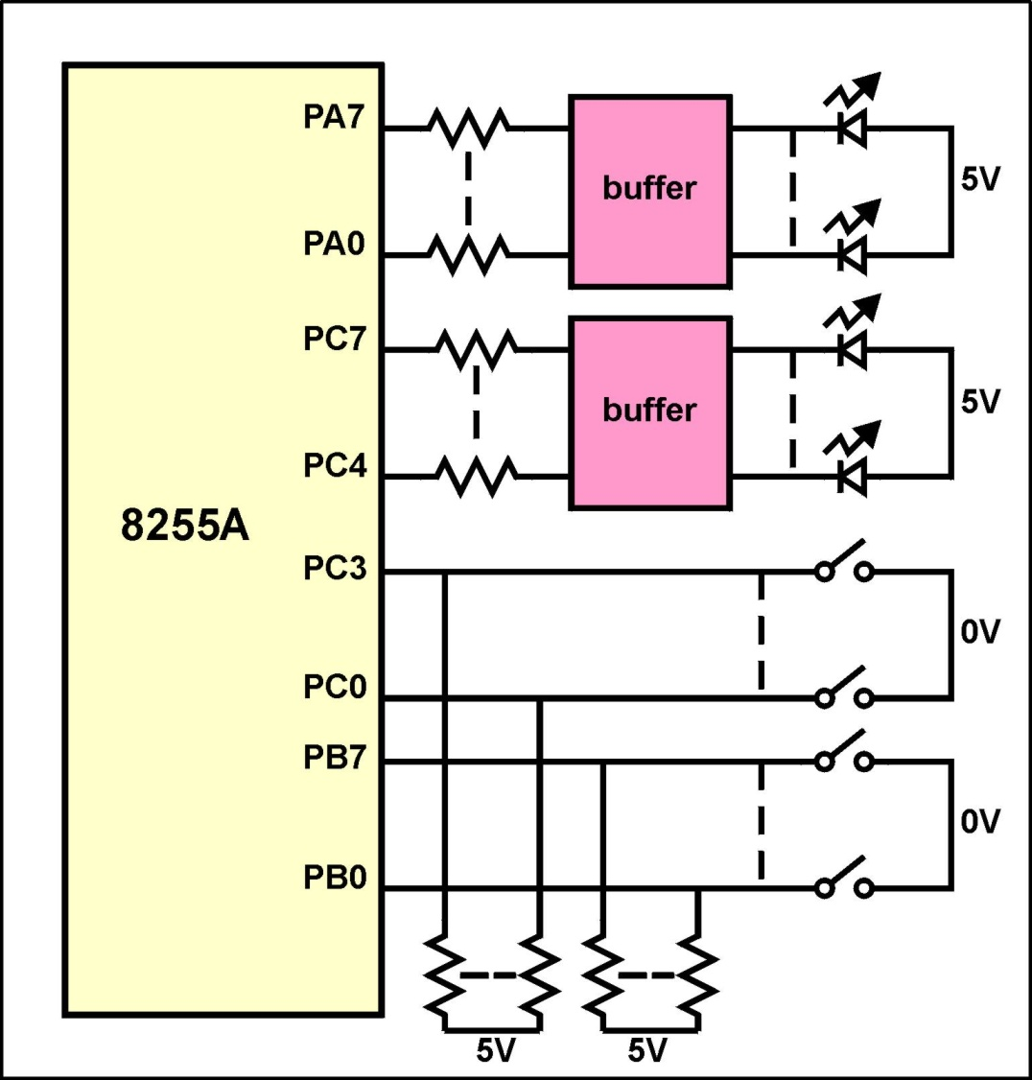
Example of 8255A Operating in Mode 0
Write a program that reads the state of the 12 switches and displays the switch state on the 12 LEDs

Slide 12
Example of 8255A Operating in Mode 0
The assembly language program is : MVI A, 83 H ;A= out B= in C(lo)= in C(hi)= out OUT F3 H ; write the control word IN F1 H ; read switches on port B OUT F0 H ; display on port A IN F2 H ; read switches on port C (lo) ANI 0F H ; mask top 4-bits - not switch data RLC RLC RLC RLC ; move bottom 4-bits of A to top OUT F2 H ; output reg A to port C

Slide 13
Operational Modes - Mode 1
In this mode handshake signals are exchanged between the port and the peripheral device prior to transfer of the data.
Ports A and B are the data ports. Port C assumes the role of supplying the handshaking signals.
The data ports are software configurable to be either input ports or output ports but not bi-directional ports.
Each data port uses 3-bits of port C for handshaking signals. The remaining 2-bits of port C are available for simple I/O functions.
Irrespective whether the data ports are input ports or output ports the data is latched.
Mode 1 supports interrupt logic

Slide 14
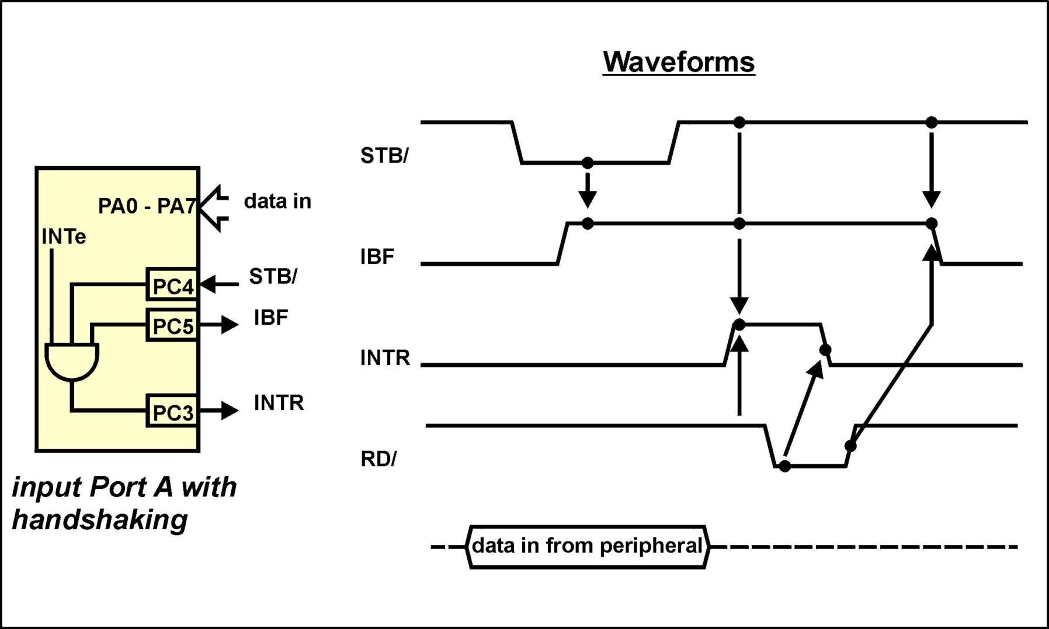
Mode 1 - Input Port with Handshaking

Slide 15
Mode 1 - Input Port with Handshaking
The peripheral checks the IBF signal to ensure the 8255A is ready for data ( i.e. the processor has read the previous data ).
The peripheral places the data it wishes to send to the processor onto the data port.
The peripheral asserts the strobe signal ( STB/ = 0 )
The 8255A latches the data on the port using the STB/ signal to enable its input latches.
After latching the data the 8255A asserts the IBF signal to tell the peripheral it has read the data and that the input latches are full.
The IBF signal remains asserted until the processor reads the data stored in the port latches.

Slide 16
Mode 1 - Input Port with Handshaking
On receiving the IBF signal from the 8255A, the peripheral de-asserts the STB/ signal.
  Alternative -- Interrupt Driven System
If the INTE bit of the port is set (accomplished by bit set facility on port C) then when both IBF and STB/ are logic ‘1’ an interrupt is generated on the ports INTR line.
With this line connected to one of the 8085A’s interrupt input pins and with processor interrupts enabled then when INTR goes high an interrupt service routine will be executed.
The ISR is required to read the data from the 8255A input port. When the data has been read from the port, the 8255A de-asserts its IBF control signal telling the peripheral device that the data has been read by the processor and that it is free to send new data.

Slide 17
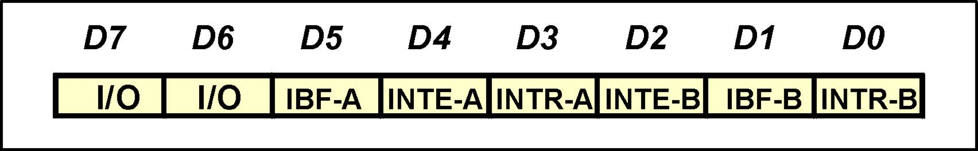
Mode 1 - Input Port with Handshaking
  Alternative -- Polled System
  An alternative to using interrupts to determine whether there is data at the input port to be read, is to poll the status of the 8255A.
  This can be accomplished by reading port C of the 8255A. The bits read have the following interpretation :
By continually reading the status and testing the appropriate
IBF bit can the processor determine if there is new data at the
input port for it to read.

Slide 18
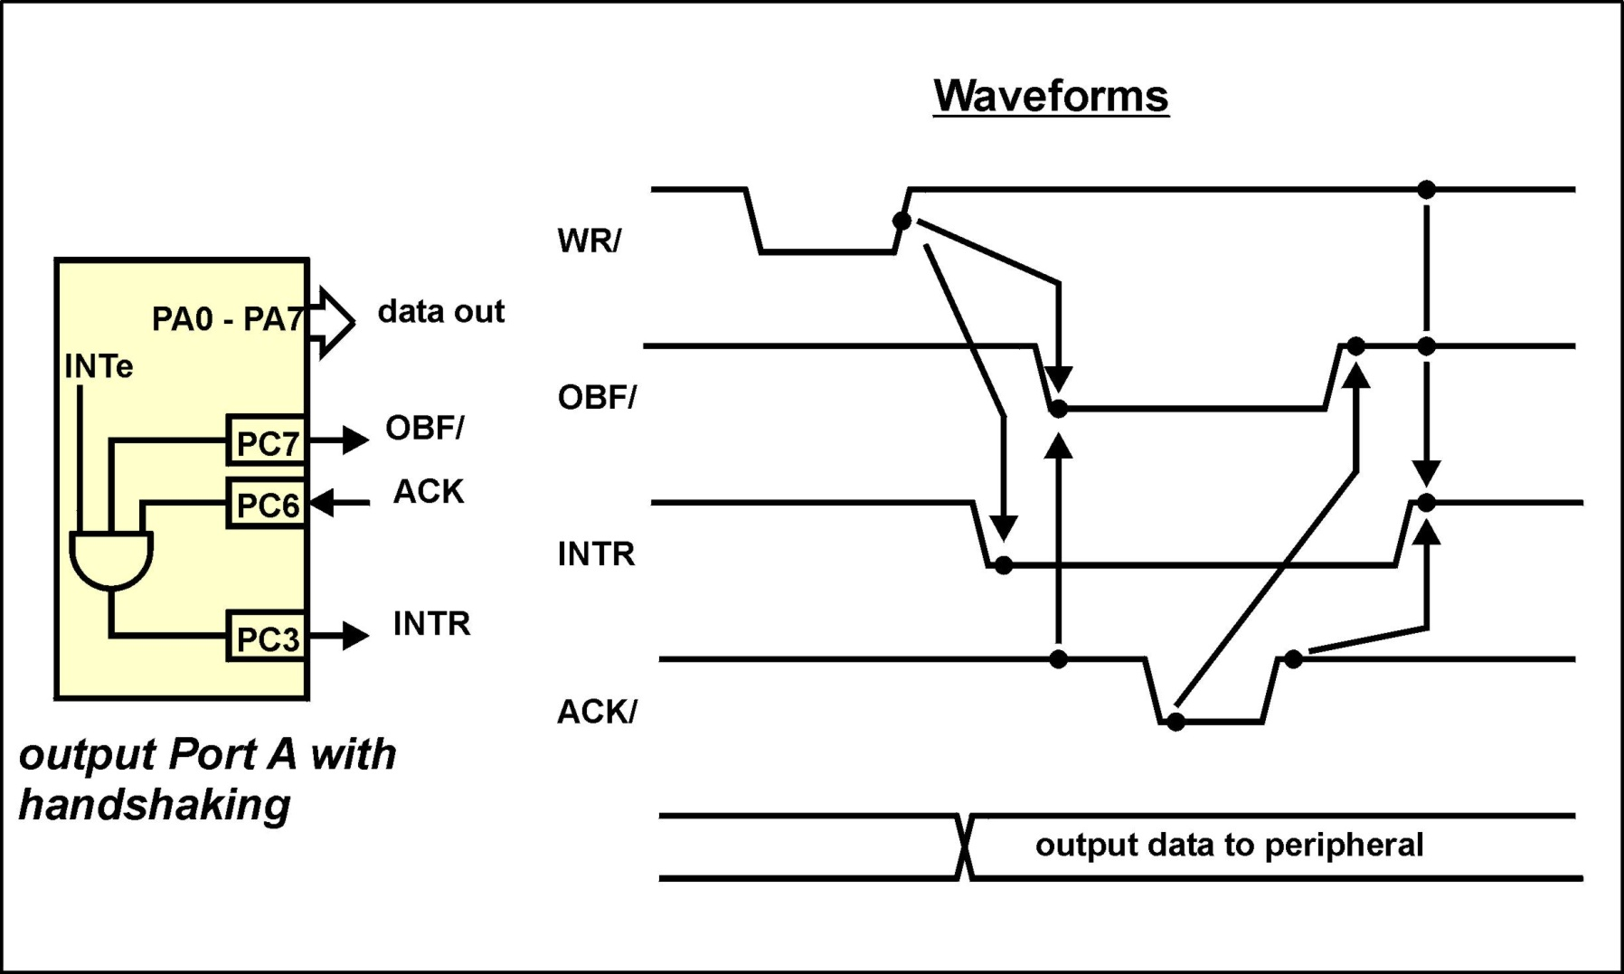
Mode 1 - Output Port with Handshaking

Slide 19
Mode 1 - Output Port with Handshaking
An initial state is assumed with the output data latches of the 8255A empty and the peripheral device is ready to accept data.
The processor writes data, destined for the peripheral, to the 8255A’s data latches. The data is latched into the 8255A on the rising edge of the WR/ control signal.
Loading data into the data latches of the 8255A clears the interrupt request output of the 8255A (INTR = 0) and asserts the output buffer full flag (OBF/ = 0).
The peripheral device reads the output data of the 8255A when it sees OBF/ asserted.
Once the peripheral has read the data, it generates an ACK/ = 0 pulse to tell the 8255A that its output data has been read.

Slide 20
Mode 1 - Output Port with Handshaking
On the negative edge of the ACK/ signal, the 8255A clears its OBF/ signal which tells the peripheral device there is no data for it to read.
On the rising edge of the ACK/ signal and provided that both WR/ and OBF/ are in the de-asserted state, the 8255A generates an interrupt to the processor (assuming interrupt mode is being used).
This interrupt effectively tells the processor that the peripheral device has read the previous data sample and is ready to receive new data if the processor has data for it.
If interrupts are not chosen as the operating mechanism, the status register of the 8255A can be polled to determine when the peripheral has read the previous data sample.

Slide 21
Operational Modes - Mode 2
When operated in Mode 2, port A becomes bi-directional.
The bi-directional operational mode for port A is supported by five handshaking signals using bits of port C.
Port B can be operated in either mode 0 or mode 1. When used in mode 1 the remaining three bits of port C assume the role of handshaking signals for port B.
If port B is used in mode 0 the remaining bits of port C can be programmed in mode 0 to be either an output port or an input port.

Slide 22
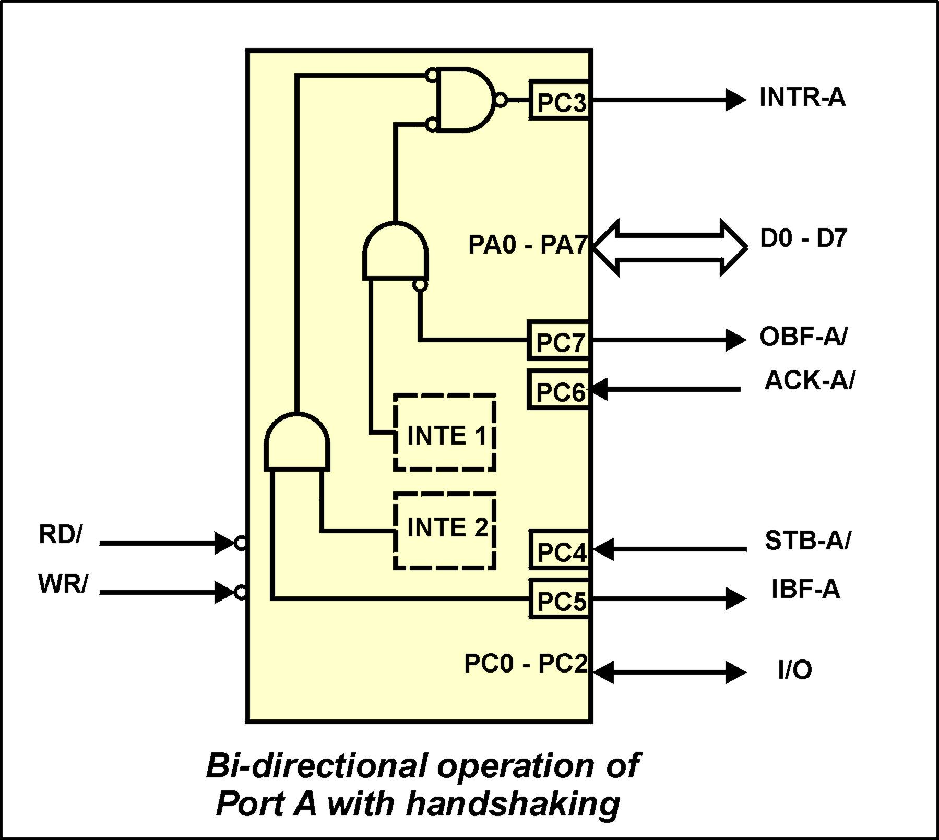
Operational Modes - Mode 2

Slide 23
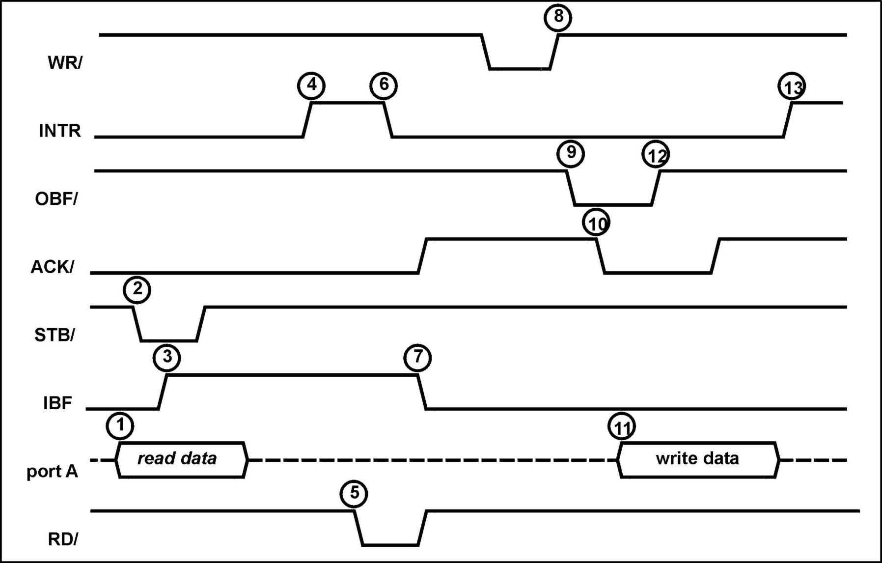
Mode 2 - Waveforms

Slide 24
Mode 2 - Sequencing
Read data from peripheral followed by writing data to peripheral
  1. Data is placed on PA0 - PA7 by the peripheral
  2. Peripheral asserts its STB/ output telling 8255 data to be read. The 8255A latches the data in its input buffers.
  3. The 8255 asserts its IBF output to tell the peripheral the data has been latched but not read by the processor.
  4. The peripheral de-asserts its STB/ output with IBF still set. The 8255A requests an interrupt ( assuming interrupts are used)
  5. Polling or interrupts are now used to service the 8255A. The 8255A input buffers are read by the processor when RD/ goes low.

Slide 25
Mode 2 - Sequencing
  6. The falling edge of RD/ resets INTR.
  7 The rising edge of RD/ resets the IBF flag to tell the peripheral the data has been read by the processor and that it can send the next data sample.
Processor write sequencing
  8. Data is output from the processor and latched by the 8255A using the WR/ processor signal.
  9. The rising edge of WR/ causes the OBF/ to be asserted, telling the peripheral device there is data for it to read.
  10. The peripheral enables its input buffers and tells the 8255A it is ready to receive data by asserting the ACK/ flag.

Slide 26
Mode 2 - Sequencing
  11. On the falling edge of ACK/, the 8255A releases its latched data onto the lines PA0 - PA7. The data is read by the peripheral device.
  12. The 8255A de-asserts its OBF/ flag telling the peripheral there is no further data to read.
  13. The rising edge of ACK/ causes the 8255A to generate an interrupt request. ( if this feature is used ). The interrupt tells the processor that the peripheral has read the data and that further data can be written to the 8255A.

Slide 27
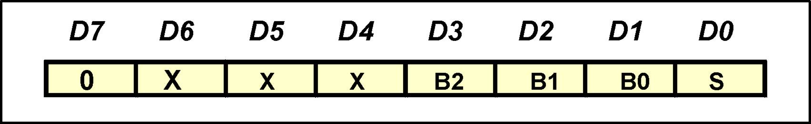
Bit Set - Reset Mode
A very useful feature of port C of the 8255A, when it is not being used for handshake operations, is its bit-set / bit-reset capability.
When port C is an output port, the individual bits of the port can be set or cleared.
This is accomplished by writing the following data word to the control port. Note bit D7 of the data is logic ‘0’. The 8255A uses this bit to distinguish between mode words and the bit-set facility.
B2, B1, B0 3-bit code specifying which bit of port C is to be
manipulated
S ‘1’ set the bit ‘0’ reset the bit.

Slide 28
Exercise

